Slide 1
CSS Introduction
ISW-512

Slide 2
Agenda
What’s CSS
Including CSS in HTML
Syntax
Selectors
Declaration
CSS properties
Box Model
Responsive Design

Slide 3
Cascade Style Sheets
Introduction

Slide 4
What’s CSS?
Cascading Style Sheets (CSS) are a method of web design that formats a web page content according to a presentation style specified by the web page author.

Slide 5
CSS Advantages
Essentially separates document content from the manner in which it is presented, thus allowing for more fluid transitions between various browser platforms.
Provides for more precise control for spacing, alignment, and positioning of content.
Font style, color, and font size can all be manipulated.

Slide 6
Embedding CSS to an HTML
There are 4 ways to do it
External Style Sheet
Internal Style Sheet
Inline Style Sheet
Via Javascript (not considered as common)
Embedding CSS rules has precedence, and can be overwritten/merged, that means that a rule in the External could be merged with the Internal and finally with the Inline

Slide 7
CSS Embedding Examples
External Style Sheets → Via a link reference in the head to a css file (recommended)
<link rel=”stylesheet” href=”style.css”/>
Internal Style Sheets → style tag declaration in the HTML document
<style> ... </style>
Inline CSS → style attribute in the element
<a href=”#” style=”..” ><a/>

Slide 8
Special note about Javascript
As you can modify the HTML document (DOM) with Javascript you could also add style tags
Also you can use a JS code to change the element’s style

Slide 9
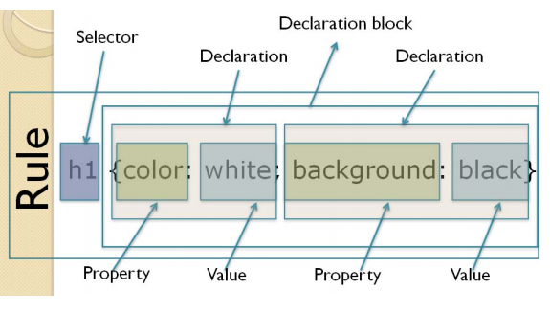
CSS Syntax Components
Rule
Selector
Declaration Block
Declaration
CSS Property
CSS Value

Slide 10
CSS Examples
h1 {
color: #eee;
text-align: center;
}
.theClassAttribute {
font-size: 14px;
text-decoration: none;
}
#theIdAttribute {
color: blue;
font-size: 20px;
}

Slide 11
Inheritance
Parent HTML element’s CSS gets automatically inherited by its childs
For example:
body {
color: #fff;
}
Will cause all html elements inside the body tag to inherited the color of the body element

Slide 12
Overwritten/Merging example
1) /style.css
h1 { color: blue; text-transform: uppercase;}
2) <style> h1 { color: yellow; } </style>
3) <h1 style=”color: red;”/>Title</h1>
Result:
TITLE
note: its red and uppercase

Slide 13
Selectors
Selector indicates which type of element should the declarations be applied to.
Types from version 1:
by class (class=”theelementclass”)
by ID (id=”theid”)
by html tag (p, a, div)
by attribute (included on CSS2,more added in CSS3)
List of CSS3 supported selectors: http://www.w3.org/TR/css3-selectors/#selectors

Slide 14
“class” Selector
On the CSS
.required {
border: red 1px solid;
}
On the HTML
..
<body>
<input class=”required” name=”name” /input>
</body>

Slide 15
“id” Selector
On the CSS
#required {
border: red 1px solid;
}
On the HTML
..
<body>
<input id=”required” name=”name” /input>
</body>

Slide 16
type or element Selector
On the CSS
input {
border: red 1px solid;
}
On the HTML
..
<body>
<input name=”name” /input>
</body>

Slide 17
Combined Selector
Combines 2 or more different selectors
Example
/*
apply style only to input elements with “required” class
*/
input.required { border: red 1px solid;}
input#name { border: red 1px solid;}

Slide 18
Grouping Selector
Let you apply same declarations to more than one selector, using the comma as the joining character
Example:
a, p.longtext, pre, h1 {
color: #444;
}

Slide 19
Child Selector
Let you apply declarations to the specific children elements of an specific parent
Example:
/*apply style to “a” elements that are inside a list item */
ul > li > a{
color: #444;
}

Slide 20
Descendant Selector
Apply to all descendants, that means childs, grand sons, etc
Example:
/*apply style to “a” elements that are inside a list item */
ul li a{
color: #444;
}

Slide 21
Workshop
Put your knowledge in practice

Slide 22
Pseudo Elements
A CSS pseudo-element is used to style specified parts of an element.
For example, it can be used to:
Style the first letter, or line, of an element
Insert content before, or after, the content of an element

Slide 23
Pseudo Elements - Syntax
selector::pseudo-element {
property: value;
}
Example:
p::first-line {
color: #ff0000;
font-variant: small-caps;
}

Slide 24
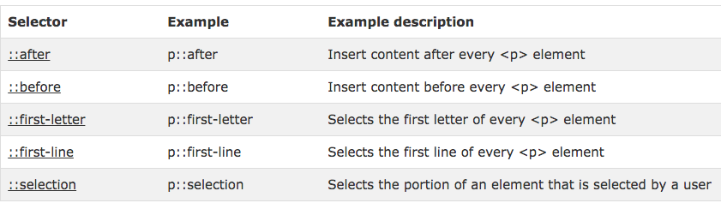
Pseudo Elements
*source: w3schools.com

Slide 25
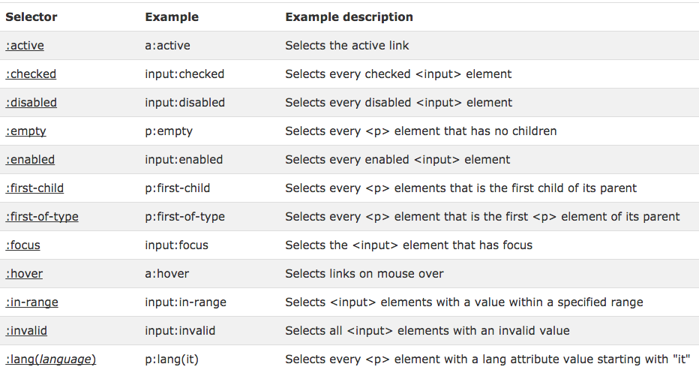
Pseudo Classes
*source: w3schools.com

Slide 26
The Box Model
All HTML elements can be considered as boxes. In CSS,"box model" is used when talking about design and layout.
The CSS box model is essentially a box that wraps around HTML elements, and it consists of: margins, borders, padding, and the actual content.

Slide 27
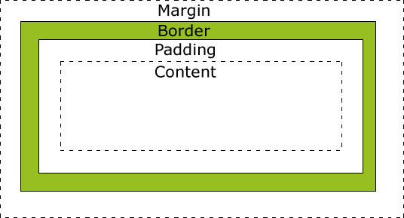
The Box Model
The box model allows us to place a border around elements and space elements in relation to other elements.

Slide 28
Box Model Components
Margin: Clears an area around the border. The margin does not have a background color, it is completely transparent
Border: A border that goes around the padding and content. The border is inherited from the color property of the box

Slide 29
… Components
Padding: Clears an area around the content. The padding is affected by the background color of the box
Content: The content of the box, where text and images appear.

Slide 30
Box Model - Determining size
In order to set the width and height of an element correctly in all browsers, you need to know how the box model works.
What is the width of an element with this css directives?:
width: 250px;
padding: 10px;
border: 5px solid gray;
margin: 10px;

Slide 31
Responsive Design
Responsive site techniques

Slide 32
First, let’s review the HTML layout rules
position: relative, absolute
Demo
display: block, table-row, none, inline-block, flex
Demo
float: left, right, clearing the float
Demo

Slide 33
What is it?
UI = Developing a website design that helps the layout to get changed according to the agent’s screen resolution.
UX= Crafting sites to provide an optimal viewing experience, easy reading and navigation with a minimum of resizing, panning, and scrolling—across a wide range of devices

Slide 34
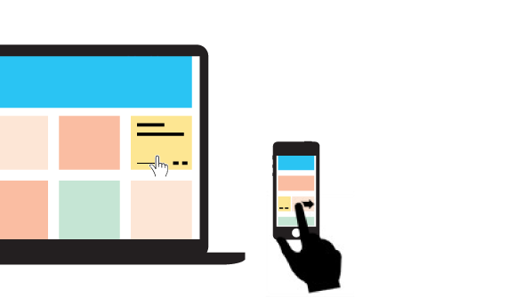
Responsive it's not limited to the UI but also the UX

Slide 35
Some Techniques
Fluid Grid → element sizing to be relative, using % instead of px and pts.
Flexible Elements → using relative sizes for html elements
Media Queries → used to define different css directives depending on the layout and size of the user’s screen.

Slide 36
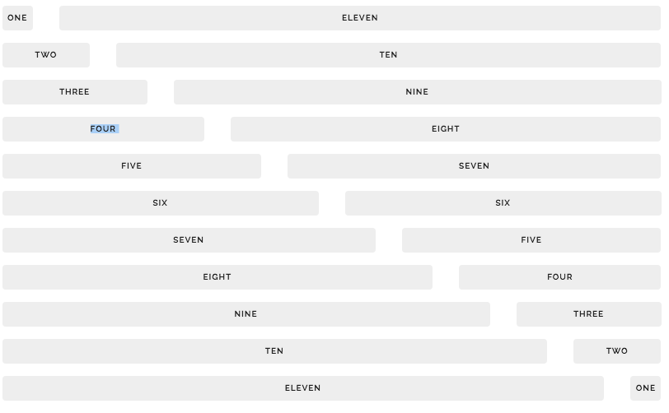
Fluid Grid Example
took from http://getskeleton.com/

Slide 37
Fluid Grid
Layout the design as a Grid, usually of 12 columns
Every element of the site will be within a cell of the Grid
Cells will accommodate proportionally when changing the size
Each cell will be a new grid
Each column has a % width size
CSS frameworks: Bootstrap, Foundation, Skeleton, Materialize

Slide 38
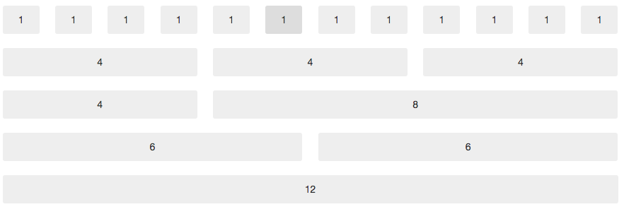
Another Grid example
took from http://getbootstrap.com/

Slide 39
Flexible Elements
Elements like: fonts, images, headings
Using rem and em as a size measure for defining sizes for elements so they adjust according to a reference element.
Demo

Slide 40
Workshop
Put your knowledge in practice

